Slide 1
Spark SQL
Group : TB、正道滴光

Slide 2
Overview
The content of paper
Overview of paper.
Theoretical of DataFrame and Catalyst optimizer.
More about Spark SQL
The disadvantages of Spark.

Slide 3
Spark & SparkSQL
Spark-on-Hadoop is a solution of large data and distributed computing.
Spark based on JVM and developed by scala.
Spark component: core, streaming, GraphX, ML-Lib, Spark SQL.
Spark SQL: a solution of SQL-on-Hadoop.
Top-to-down three layers: application (DataFrame), distributed execution (Spark), data storage (HDFS).

Slide 4
Overview of paper
Contribution
Presented a new module (SparkSQL) in Apache Spark providing rich integration with relational processing.
Automatic optimization, complex pipelines that mix relational and complex analytics.
Support a wide range of features tailored to large-scale data analysis.
Integrate DataFrame API into SparkSQL.
Use Catalyst to optimize SparkSQL.

Slide 5
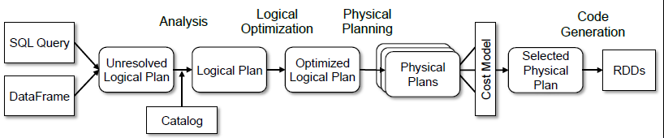
Overview of paper
Summary
SparkSQL is a SQL engine for distributed data processing.
It uses DataFrame as abstract data type which is like table in SQL.
An optimizer called Catalyst make SparkSQL faster.
Theoretical analysis
Aggregated with compiler principle, SparkSQL is very similar.

Slide 6
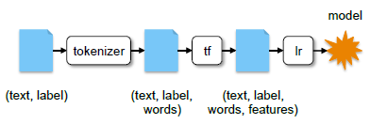
Overview of paper
Theoretical analysis
Easy to expand for rules and optimization.
Support schema inference for semi-structured data, integration with Spark's machine learning library (pipeline), and query federation to external databases.
Example of pipeline:

Slide 7
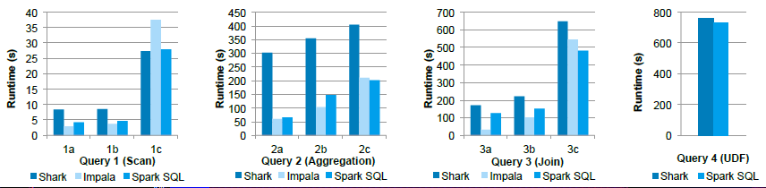
Overview of paper
Metrics
Benchmark:
Faster for large dataset and good at aggregation and join (relation).
Maybe slower using Python’s UDT.

Slide 8
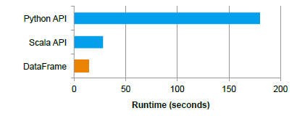
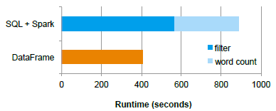
Overview of paper
Metrics
DataFrame performance rather than other language API (left):
Pipeline performance of 2-stage (right):
Dataset
AMPLab big data benchmark.

Slide 9
Overview of paper
Future work
Generalized online aggregation.
Computational genomics for large where condition.

Slide 10
RDD model
RDD: Resilient Distributed Dataset. A limited shard-memory-model programming API.
Difficulty in machine learning: MapReduce’s read / write is IO-bound and waste time.
RDD is created by another RDD (dependency) using map / join / filter / etc.
Computation of RDD (transformation / action).
RDD can be an object in Spark.
Only action compute processed in Spark (lazy evaluation).

Slide 11
DataFrame: RDD with structure
DataFrame is like table in database, stored by column.
RDD (2011) -> DataFrame (2013) -> Dataset (2015).
Dataset: DataFrame with Encoder, support strongly-typed and untyped API.

Slide 12
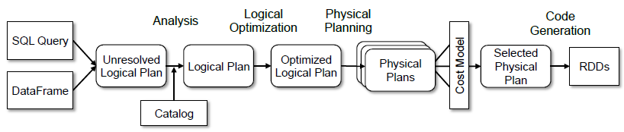
From Spark SQL to RDD
SQL query -> logical plan -> physical plan -> show.
Logical plan: -> unresolved logical plan (only data structure) -> analyzed logical plan (AST with Literal / information) -> optimized logical plan (fixed AST after optimization).
Physical plan: -> iterator [physical plan] (list of physical plans) -> Spark plan (optimal physical plan) -> prepared Spark plan (partition, node reusing, code generation).

Slide 13
From Spark SQL to RDD
SQL: a DSL (domain specific language), not Turing complete.
Lexer & parser: ANTLR, a LL(*) parser.
Catalog: resource information & metadata management.
Rule: strategy to process unresolved logical plan AST.
Optimizer: batch finish analysis, batch union, batch subquery, batch replace operators, batch aggregate, batch operator optimizations, etc.
Spark plan: record metadata and metric, processing partition and ordering, execute in Spark Core.

Slide 14
Catalyst: platform independent framework
Internal Row: a row of data.
Methods: numFields, update, get, set.
Tree Node: class of tree structure.
Methods: foreach, map, collect, etc., transformUp, transformDown.
Always in memory (never dump to disk).
Subclasses: Expression and QueryPlan (LogicalPlan, SparkPlan).
Expression: IO, literal expression, attributes, core operation, equivalence measure.
Data types: NumericType, ArrayType, MapType, StructType, etc.

Slide 15
Spark’s Disadvantages
Wrong direction in Spark 2.0: most changes are SQL.
Speed up, structured streaming, SQL 2003.
Spark survey 2015:
69% customers are using SparkSQL and 62% using DataFrames.
Biggest use cases are Business Intelligence (68%) and Data Warehousing (52%), both are SQL areas.
Code size increment basically in Spark SQL and ML-lib.
Spark is moving from a general purpose execution engine to distributed SQL data processing engine.

Slide 16
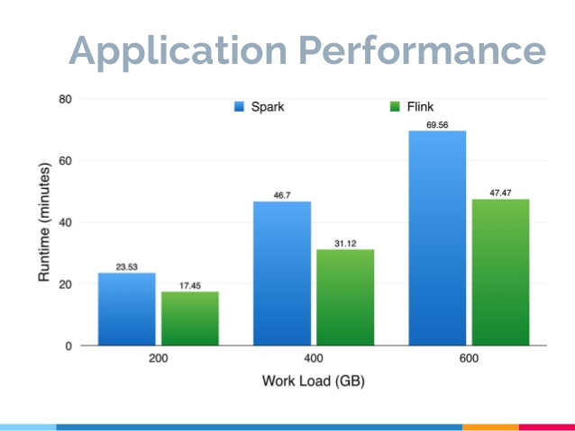
Alternatives: Apache Flink

Slide 17
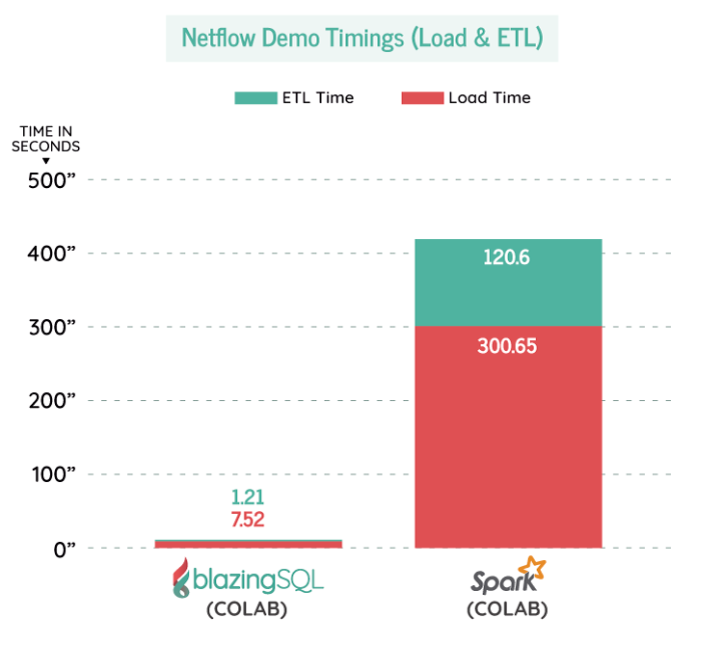
Alternatives: Blazing SQL

